Slide 1
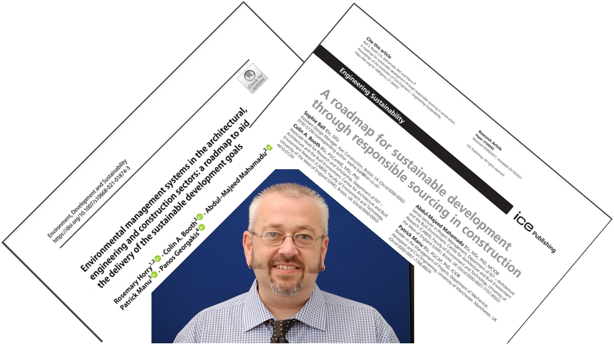
Sustainable Building Today for a Better Tomorrow
Category: Research with Impact - Institution

